Slide 1
World Bank’s Revenue Dashboard A Tool for Benchmarking Tax Policy Performance
Fiscal Policy and Sustainable Growth Unit
Macroeconomics, Trade and Investment
Equitable Growth, Finance and Inclusion Vice-Presidency

Slide 2
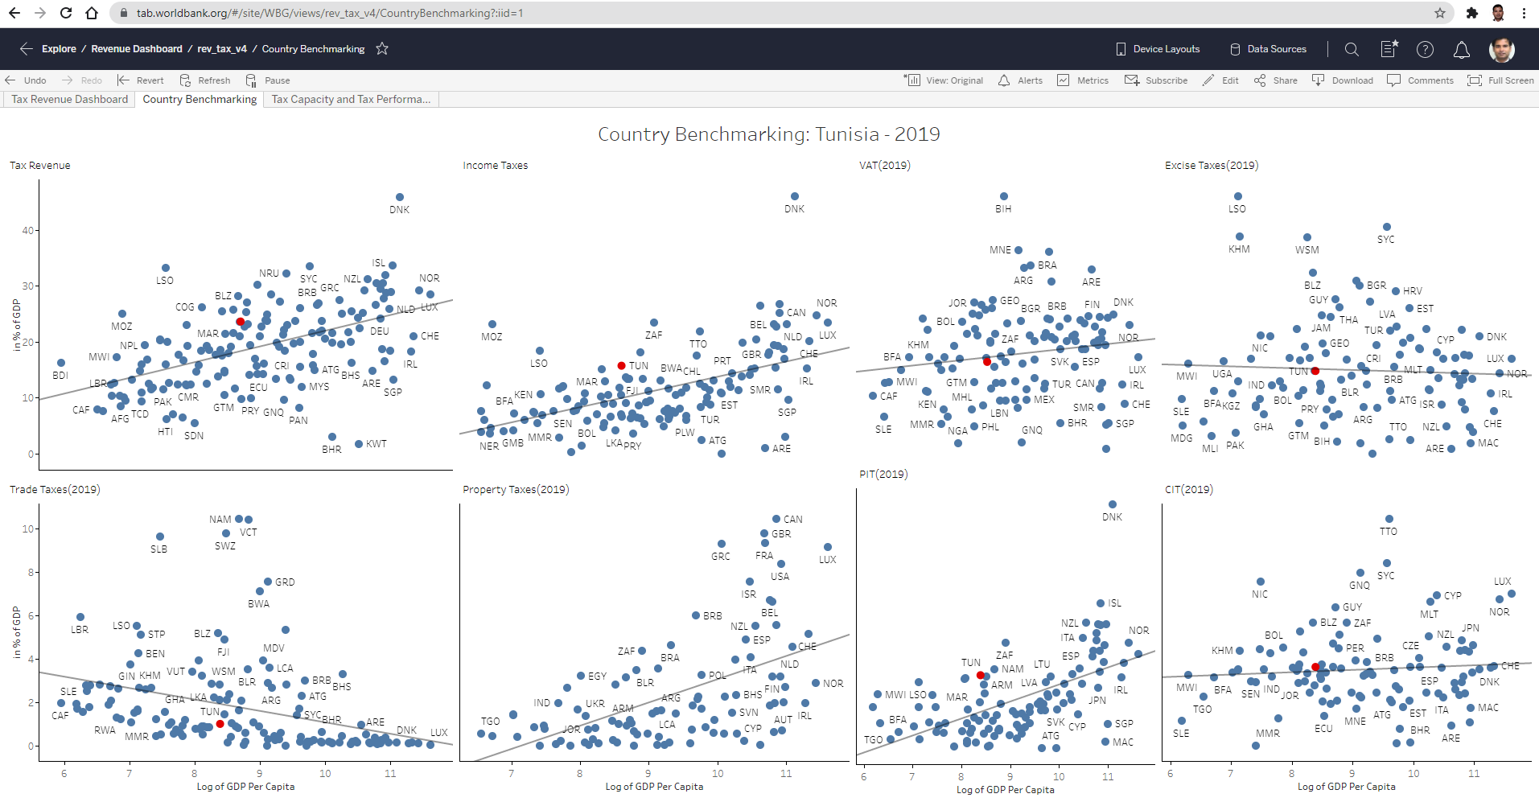
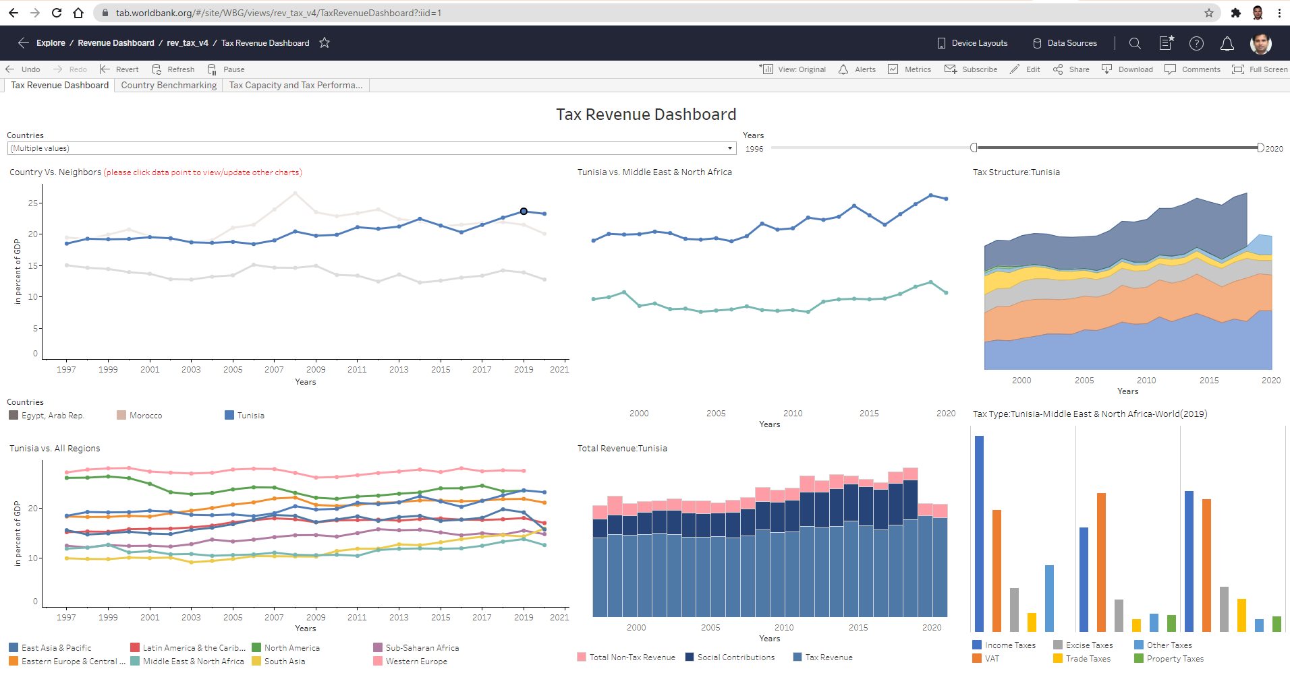
Revenue Dashboard - Overview
A tool to aid World Bank Staff and policy makers and researchers outside with high-level analysis of the performance of a country's tax system
Benchmarks a country’s tax performance with their neighbors and other comparator countries.
Allows analysis of tax trends and tax structure.
Compares a country’s performance with the average and best performer (Tax Capacity/Tax Gap)
Is available on an easily accessible Web-based platform.
Currently uses tax collection data will be expanded to include other relevant data such as C-efficiency, METR & AETR.
The latest year for which data is available is 2020. A HIGH FREQUENCY REVENUE DASHBOARD that provides more recent revenue data from different countries on a monthly/quarterly basis will be piloted soon.
Click here to go to the Dashboard

Slide 3
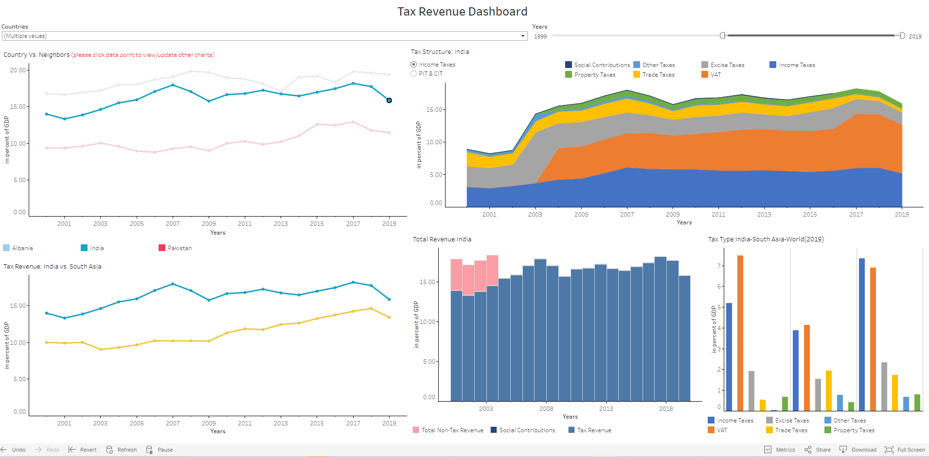
Dashboard Components - Tax Revenue Dashboard
The dashboard uses GRD dataset from UNUWider and updated from the different country’s ministry of finance websites.
Tax Rates are sourced from KPMG’s online dataset.
Focuses mainly on interactivity and filters
Single or multiple countries can be selected from “Countries” filter and time period can be selected using “Years” slider
Clicking on any data point in “Countries vs Neighbors” chart updates the remaining charts
“Tax Type: Country-Region-World” comparison chart is updated based on the selection of the country year.
Click here to go to the Dashboard

Slide 4
Navigating the Dashboard
Use slider to select the years of interest
Use drop-down list to select or type the country name
Click on country of interest and year. This activates the other charts including those in the other dashboards.
Click on an empty part of the chart to highlight all the country-line charts.

Slide 5
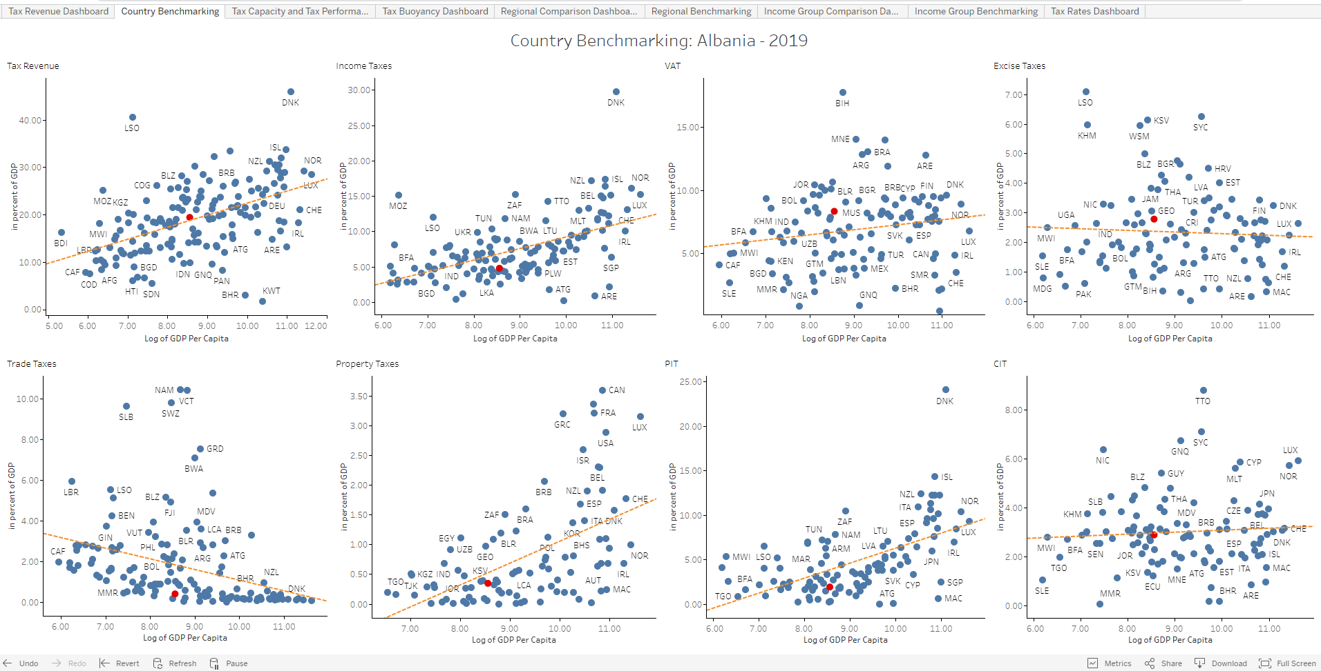
Dashboard Components - Country Benchmarking
Country of interest is indicated in red
Country Benchmarking Dashboard is updated for each Country and Year combination (can be selected in “Country vs Neighbors” chart from “Tax Revenue” dashboard).
It helps us to understand how the selected country is doing with respect to other countries with similar GDP per Capita or Income Group for Tax Revenue, Income Taxes, VAT, Excise Taxes, Trade Taxes, Property Taxes, PIT, and CIT

Slide 6
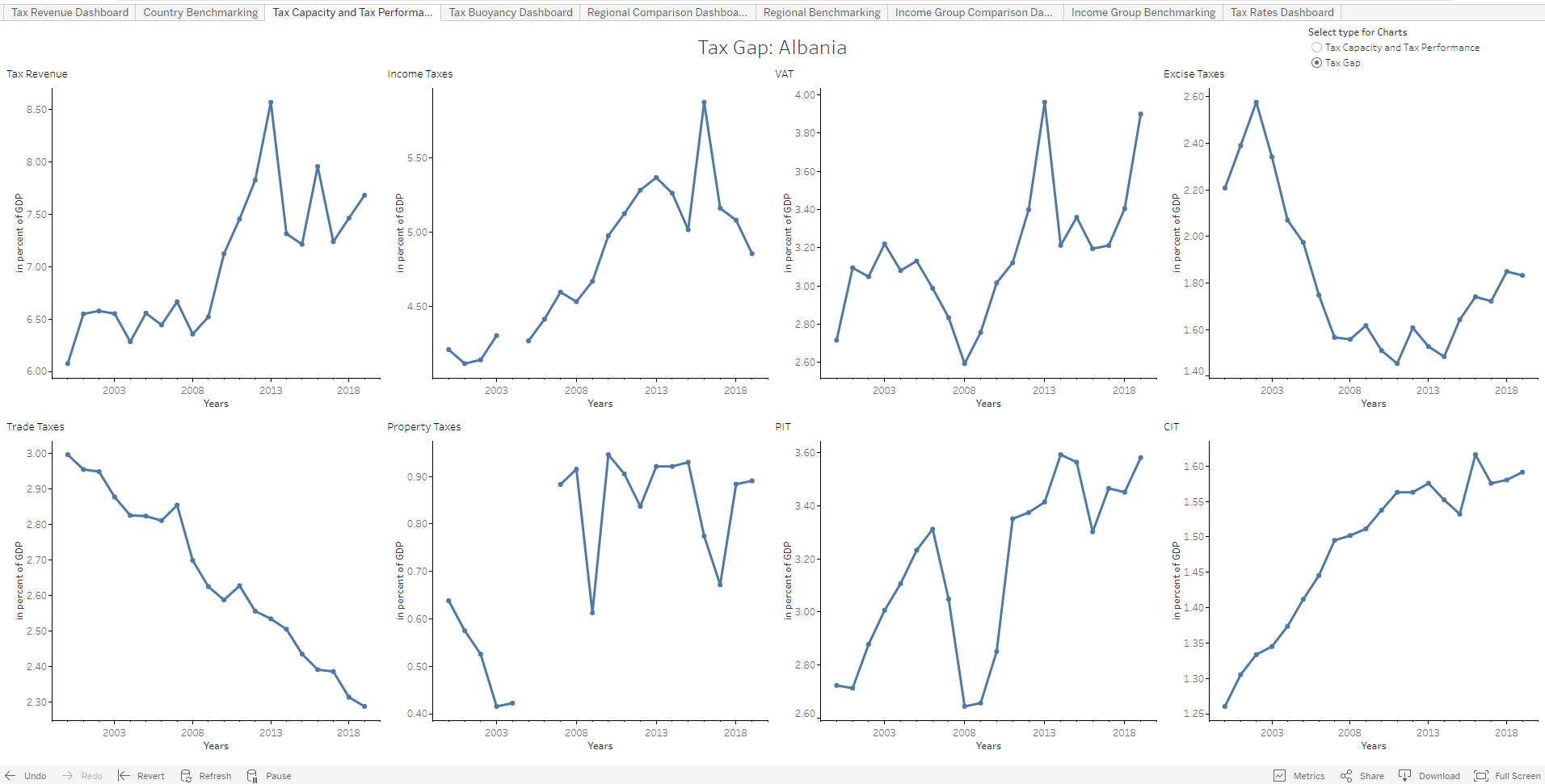
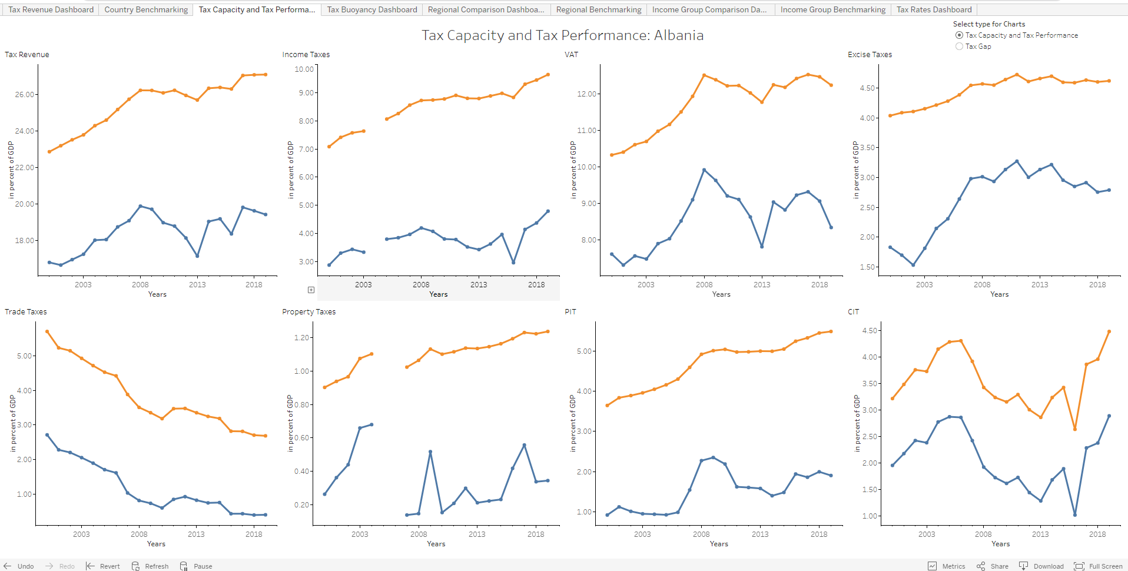
Dashboard Components - Tax Capacity and Tax Performance
Tax Capacity and Tax Performance Dashboard is updated for each Country (can be selected in “Country vs Neighbors” chart from “Tax Revenue” dashboard).
It helps us to compare the potential of the selected country with the actual values with respect to other countries with similar GDP per Capita or Income Group with respect to Tax Revenue, Income Taxes, VAT, Excise Taxes, Trade Taxes, Property Taxes, PIT, and CIT.
The potential of Country is calculated using Stochastic Frontier Analysis controlling for per capita GDP and the openness.
Choose the Tax Gap or Tax Capacity vs Tax Revenue Charts

Slide 7
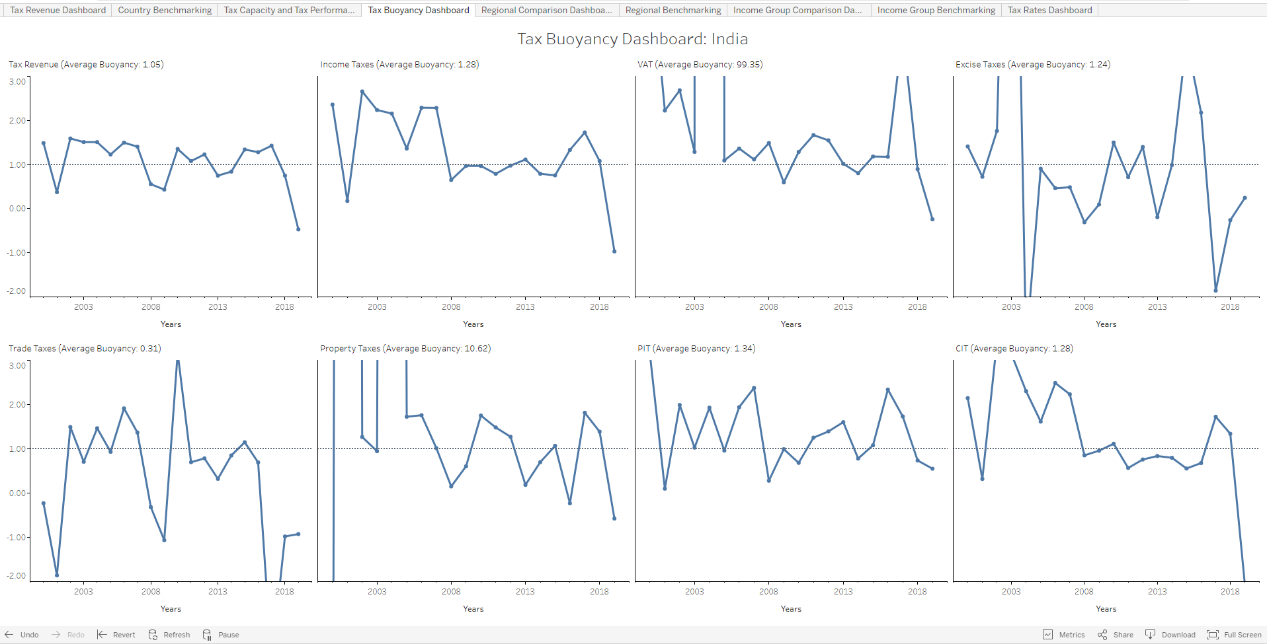
Dashboard Components – Tax Buoyancy Dashboard
The Tax Buoyancy Dashboard provides the buoyancy for Tax Revenue and the major taxes, PIT, CIT, VAT, Excises and Property Taxes.
The country and years are selected from the Tax Revenue Dashboard.
The charts shows the Buoyancy=1 line for reference and calculates the average buoyancy for the selected years.

Slide 8
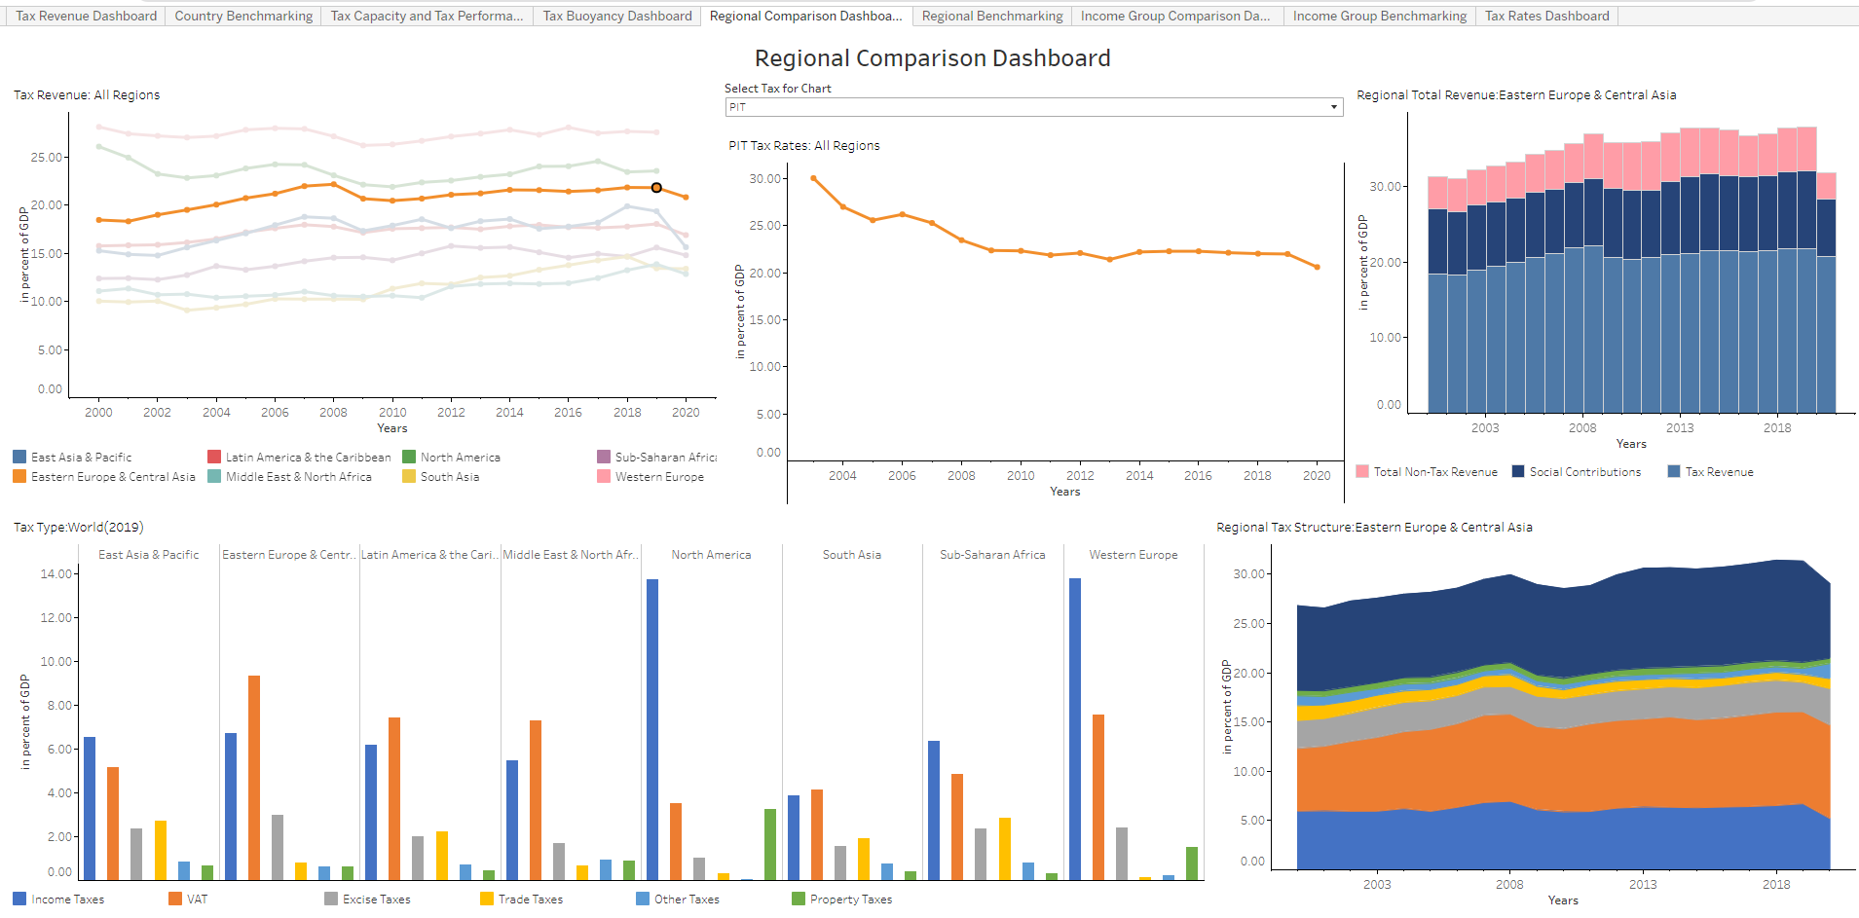
Dashboard Components - Regional Comparison
Clicking on any data point (Region, year) in the “Tax Revenue-All Regions” chart updates “Tax Rates : All Regions”(top middle), “Regional Total Revenue” (top right), and “Regional Tax Structure” (bottom right) charts.
Years are selected from the Tax Revenue Dashboard.
Average Tax Rates for PIT, CIT and VAT for the region are shown in the top-middle chart.
Un-weighted averages are used.
Click on region of interest and year. This activates the other charts including those in the other dashboards.

Slide 9
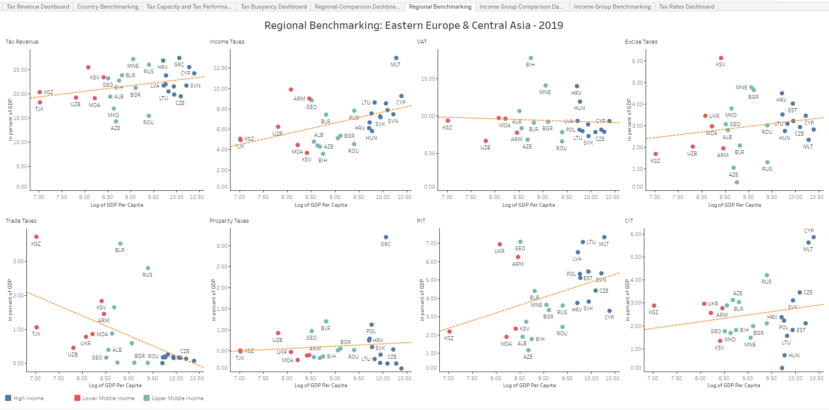
Dashboard Components - Regional Benchmarking
Regional Benchmarking Dashboard shows the countries in each region and their performance on tax collection. The Region can be selected in “Tax Revenue-All Regions” chart from “Regional Comparison” dashboard).
It helps us understand and compare the performance of all countries within the selected region for Tax Revenue, Income Taxes, VAT, Excise Taxes, Trade Taxes, Property Taxes, PIT, and CIT
The countries are color coded by Income Group

Slide 10
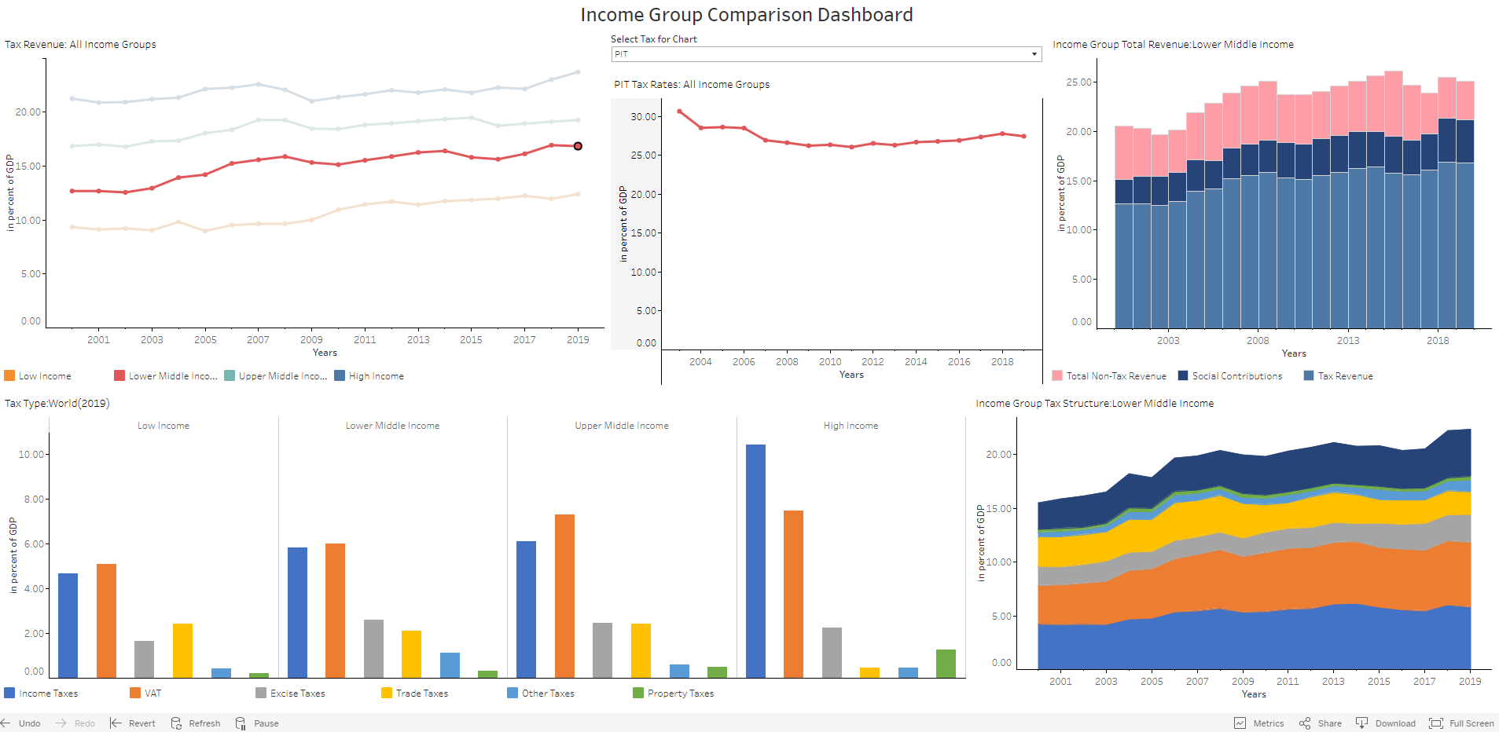
Dashboard Components – Income Group Comparison
Clicking on any data point (Income Group, Year) in the “Tax Revenue-All Income Groups” chart updates “Tax Rates : All Regions”(top- middle), “Income Group Total Revenue” (top-right), and “Income Group Tax Structure” (bottom right) charts.
Years are selected from the Tax Revenue Dashboard.
Average Tax Rates for PIT, CIT and VAT for the selected income group are shown in the top-middle chart.
Un-weighted averages are used.
Click on income group of interest and year. This activates the other charts including those in the other dashboards.

Slide 11
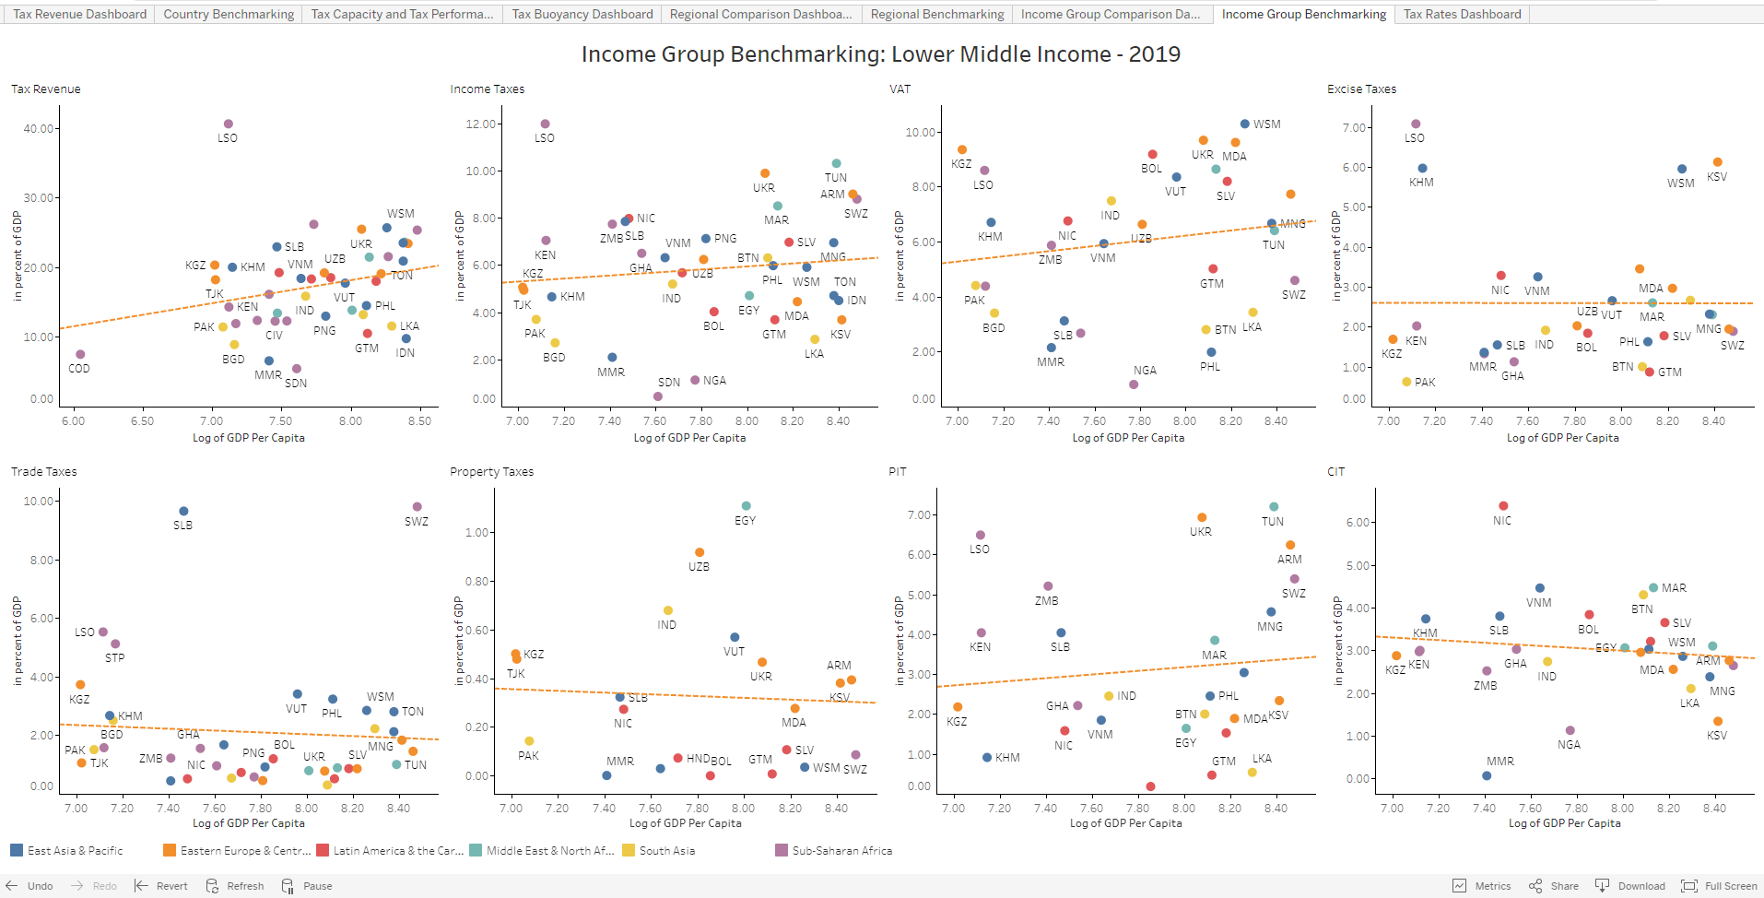
Dashboard Components – Income Group Benchmarking
Income Group Benchmarking Dashboard is updated for each Income Group (can be selected in “Tax Revenue-All Income Groups” chart from “Income Group Comparison” dashboard) and Year combination (can be selected in “Country vs Neighbors” chart from “Tax Revenue” dashboard)
It helps us to understand and compare the performance of all countries within the selected Income Group for Tax Revenue, Income Taxes, VAT, Excise Taxes, Trade Taxes, Property Taxes, PIT, and CIT.
The countries are color coded by Region Group.

Slide 12
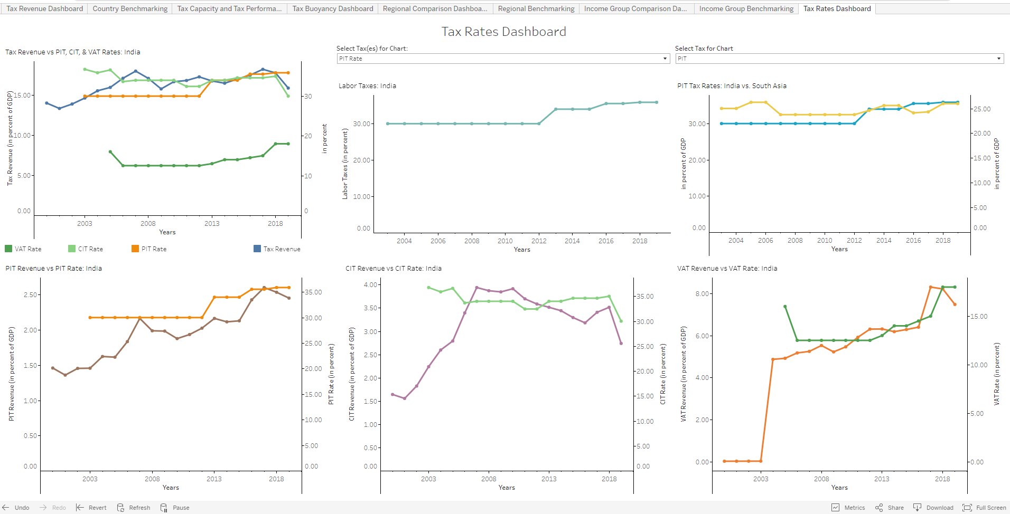
Dashboard Components – Tax Rates Dashboard
The Tax Rates Dashboard provides the tax rates for the major taxes, PIT, CIT, VAT and Social Security Taxes.
The country is selected from the Tax Revenue Dashboard.
The Tax Revenue vs Rates Chart (top-left) shows the performance of Tax Revenue versus the tax rates for the three major taxes. Individual charts (bottom row) shows the performance of each of these taxes along with the tax rate.
The Labor Taxes chart (top-middle) shows the various taxes/Social Contributions applied on labor.
The Tax Rates vs Region chart shows how the selected countries’ tax rate compares to that of the region.

Slide 13
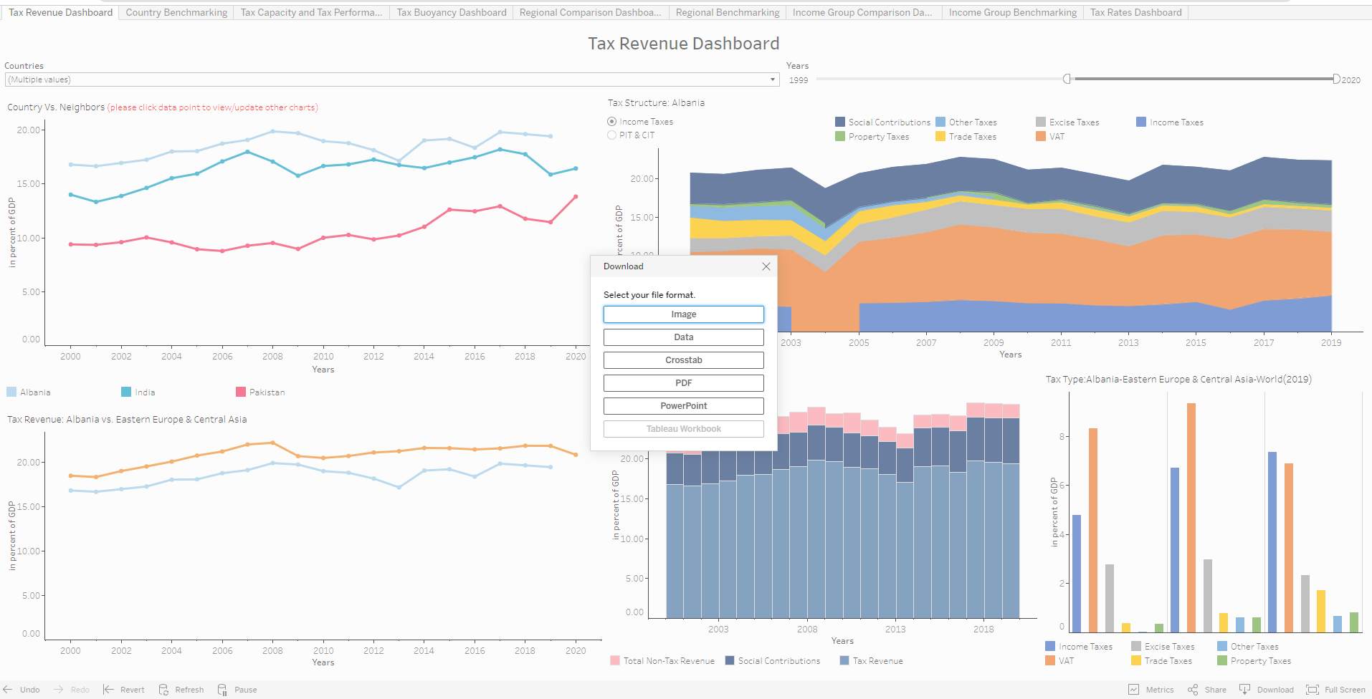
Downloading Data and Charts
Selecting Download activates various options to download Data (csv/Excel) and Charts. Selecting PDF/PowerPoint allows selection of individual charts

Slide 14
Something more…
A HIGH FREQUENCY REVENUE DASHBOARD that provides more recent revenue data from different countries on a monthly/quarterly basis will be piloted soon.
Users can subscribe to these dashboards to receive periodical updates.
Users can also define alerts based on data conditions to receive critical updates.
Data updating will be carried on periodically.

Slide 15
Thank you
Contacts:
Sebastian James, sjames2@worldbank.org
Nikhil Brahmankar, nbrahmankar@worldbank.org

